Slide 1
TECHNICAL SPECIFICATIONS

Slide 2
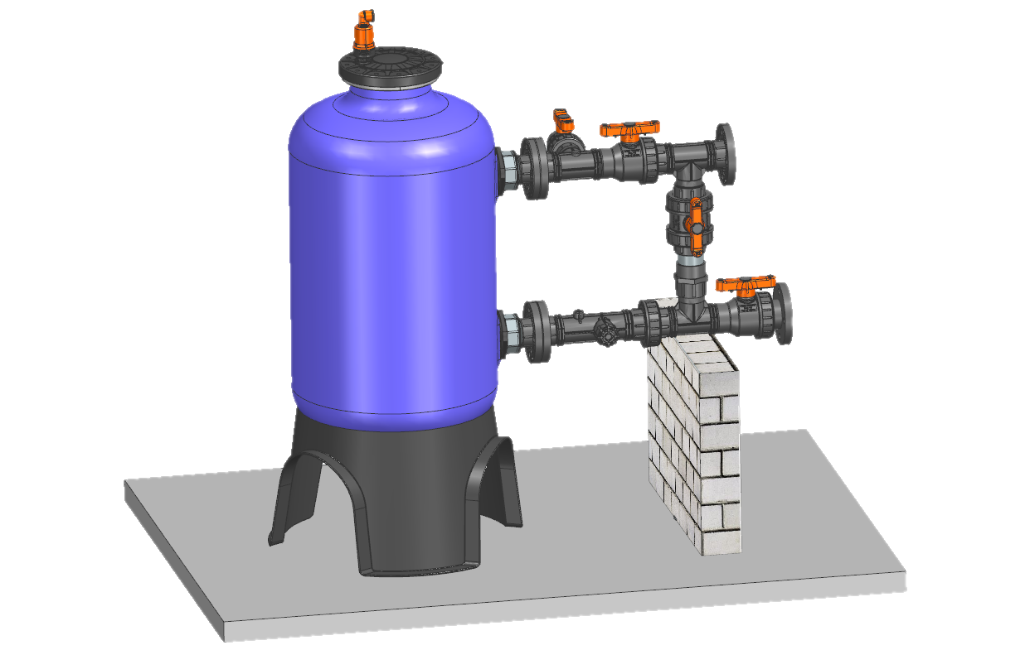
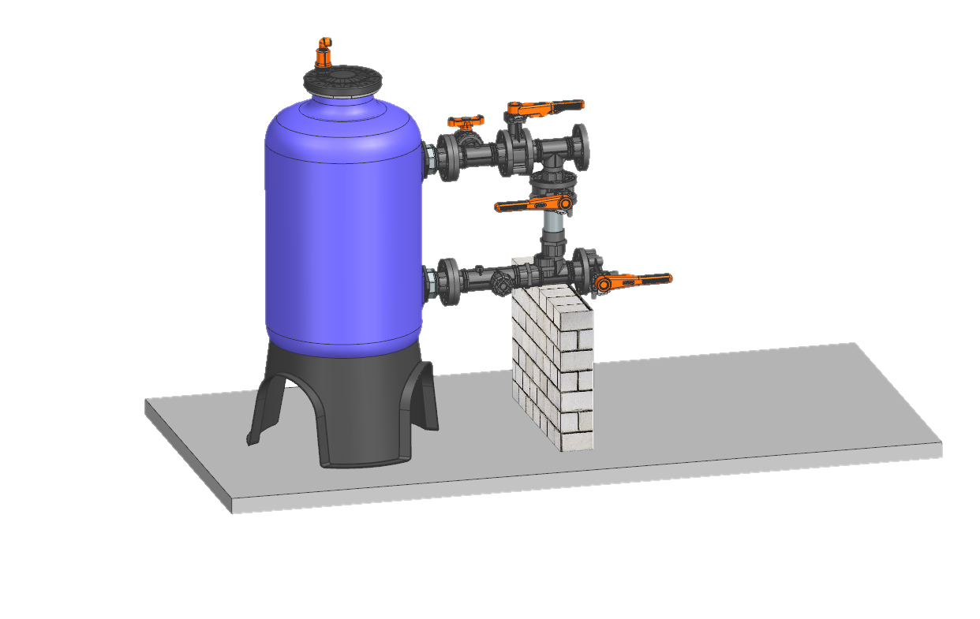
RUST PROOF MEDIA FILTER
RUST PROOF MEDIA FILTER WITH BALL VALVE
WITH
5 YEARS WARRANTY
BACK FLUSH
INLET
OUTLET
RUST PROOF MEDIA FILTER WITH BUTTERFLY VALVE
BACK FLUSH
INLET
OUTLET

Slide 3
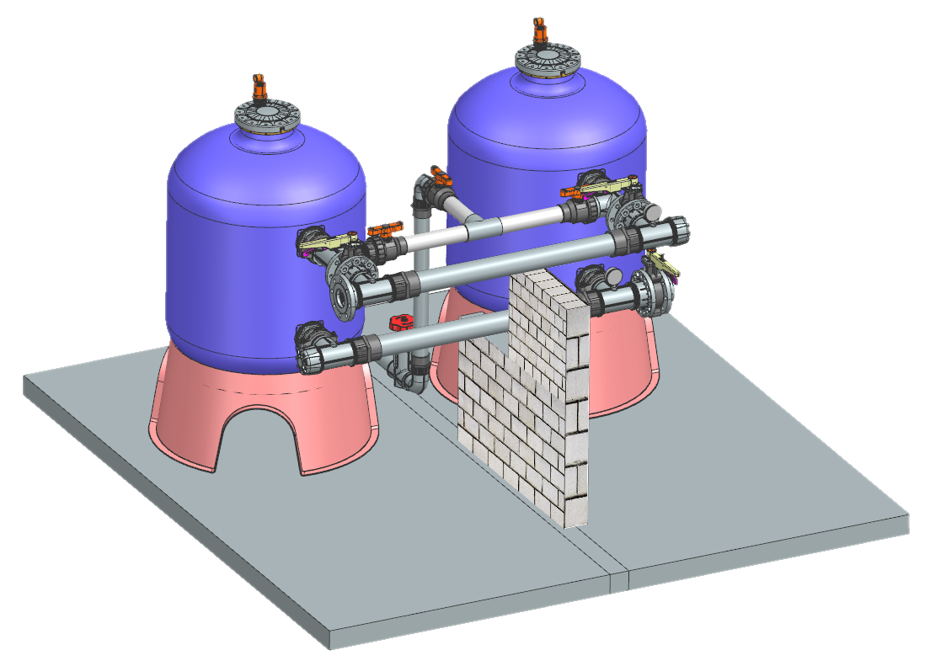
RUST PROOF TWIN MEDIA FILTER
BACKFLUSH MANIFOLD
INLET MANIFOLD
MANIFOLD SUPPORT
OUTLET MANIFOLD

Slide 4
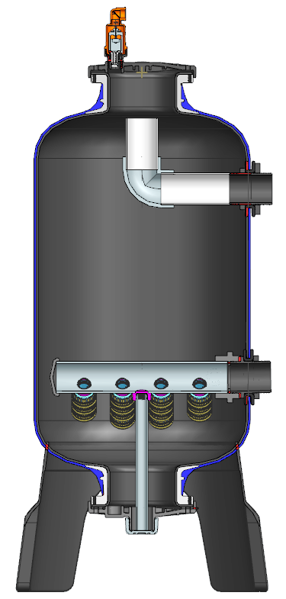
PRODUCT ILLUSTRATION & COMPONENTS
1” CARV
TOP COVER
INLET CONNECTION FLANGED /THREADED/GROOVED COUPLING
FRP MEDIA TANK
UNDER DRAIN SYSTEM
OUTLET CONNECTIONFLANGED/THREADED/GROOVED COUPLING
UNDER DRAIN SUPPORT
SKIRT/STAND
BOTTOM COVER
SAND DRAINAGE PORT

Slide 5
APPLICATION:
Primary filtration for agriculture drip, micro & Land Scape -irrigation systems using surface water taken from Open wells , Ponds , Rivers , lakes having Organic & Biological contaminants, silt and clay.
Suitable to use with fertilizers and acids.
Suitable to use in high humid areas.
FEATURES AND BENEFITS:
Made from high quality engineering plastics wrapped with FRP for getting mechanical strength.
Light Weight , having 55% Less weight than Metal filters & Is Equally Strong.
The tank is inserted with a PE liner to get smooth surface inside to reduce wear and head loss with Aluminum collars and coted with glass fiber fabrics which is the strongest & most durable material having best impact resistance & Good Corrosion & Chemical resistance.
FRP coating is UV stabilized having minimal effect of UV on it and work for years.
FRP works in all weather conditions & harsh climate.
Easy for installation & Maintenance.
Flexible to add no of filters for future expansion.
It comes with Lifetime anticorrosion warranty.

Slide 6
TECHNICAL SPECIFICATION
TABLE-1
General:
Specifications | Tank Size | Connection Size | HT-563 | HT-564 | HT-565 | HT-566 | HT-567
Inlet/Outlet Connections | 20" | 2” | Threaded/Flanged/Grooved coupling | ─ | ─ | ─ | ─
 | 24" | 2.5” | ─ | Threaded/Flanged | Threaded / Flanged
 | 30" | 3” | ─ | ─ | ─ | Threaded/Flanged/Grooved coupling | Threaded/Flanged/Grooved coupling
Empty Tank Weight (kgs) |  |  | 36 | 36 | 42 | 42 | 52
Empty Tank Volume (liter) |  |  | 145 | 145 | 230 | 230 | 320
Maximum Recommended Pressure |  |  | PN 4
Maximum Recommended Flow (m3/hr) |  | 2” | 25 | ─ | ─ | ─ | ─
 |  | 2.5” | ─ | 30 | 40 |  | ─
 |  | 3” | ─ | ─ | ─ | 40 | 50
Flow range (m3/hr) |  |  | 20~30 | 27~35 | 35~45 | 35~45 | 45~52
Recommended Sand Bed Height (mm) |  |  | 400 | 400 | 400 | 400 | 370
Sand Quantity (kgs) |  |  | 150 | 150 | 200 | 200 | 350
Material of Construction
Tank |  |  | FRP
Seals |  |  | EPDM
Flutes |  |  | PPGF
Filter Covers |  |  | PPGF
Back Flushing Data:
Back Flush Valve |  |  | 1.5" PP Ball Valve | 2" PP Ball Valve | 2" PP Ball Valve | 2" PP Ball Valve | 2" PP Ball Valve
Flushing Cycle Time* (Seconds) |  |  | 90 Seconds
Back Flushing Flow (m3/hr) |  |  | 12~14 | 12~14 | 14~16 | 14~16 | 16~18
Back Flushing frequency* |  |  | Once every 3 hrs
Recommended Backwash Pressure |  |  | 1.5 kg/cm2
Note:- * Flushing Time and no of cycles per day, Depends On Quality of water.

Slide 7
INSTALLATION & OPERATION

Slide 8
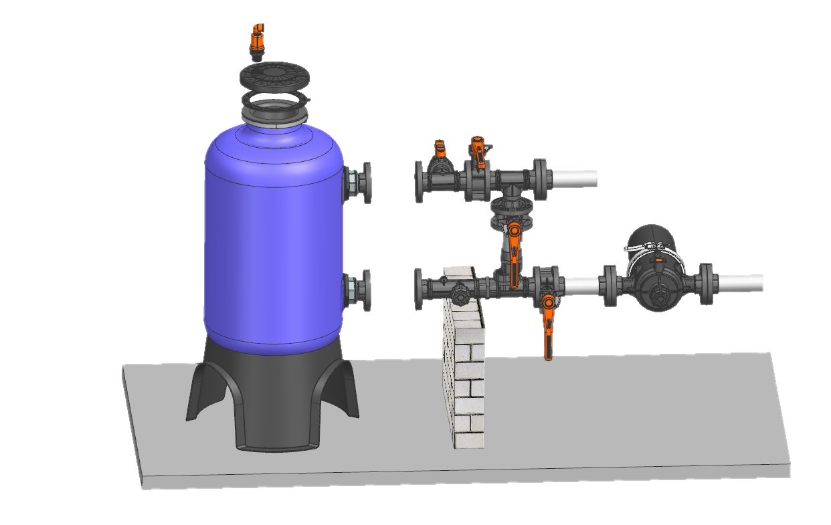
Stand alone Media Filter Installation
Fig 1
Fig 2
Place filter on concrete platform with support as shown in fig 1.
Install backwash assembly (As shown in Fig. 2) by joining the flanges / Grooved coupling with nut bolts as shown in fig 1 .
Position & align tank & connect inlet to water source and outlet to the inlet of secondary filter as shown in fig 1.
Connect outlet of the secondary filter to the field.
First fill approximately half tank with water & rotate elbow to downward to avoid sand from entering in the inlet pipe . Fill sand in tanks till marked level. Do not fill sand in dry tank.
Rotate back elbow to its original position again after filling sand
Put rubber gasket & close Top cover by cross closing nut bolts.
Install CARV in the top cover as shown in fig 1.

Slide 9
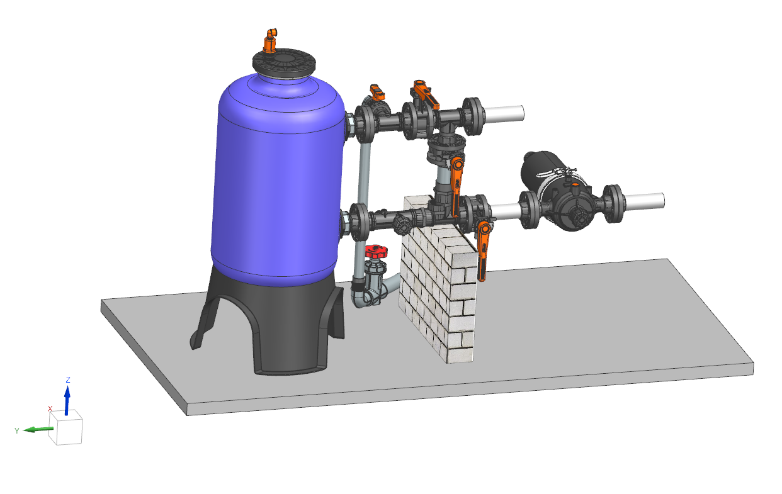
INSTALLATION & OPERATION MANUAL SAND MEDIA FILTER
A
START UP
C
D
B
E
Close downstream valve B & open valves A,C & D & start the pump
Gradually close inlet valve A such that backwash flow match with flow shown in table 1 as per model to wash sand & wash out dust from sand for 5 minutes. It will remove dust present in the sand & prevent instant chocking of secondary filter & drippers.
Set the desired backwash discharge as shown in table-1 by adjusting backwash-throttling valve E. & check backflush water for any sand coming out from it . No sand should come out from backflush valve.
Remove handle of backwash throttling valve E to avoid change of setting of this valve.

Slide 10
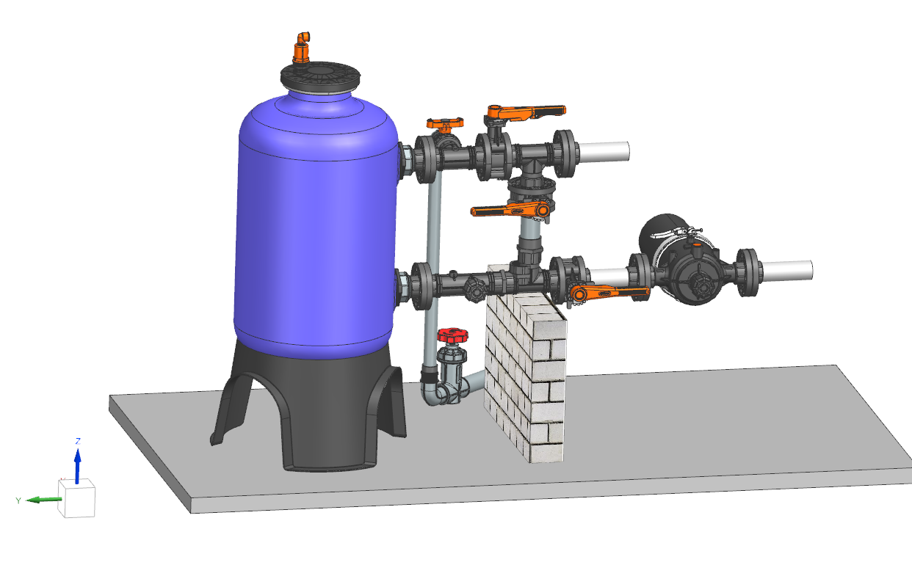
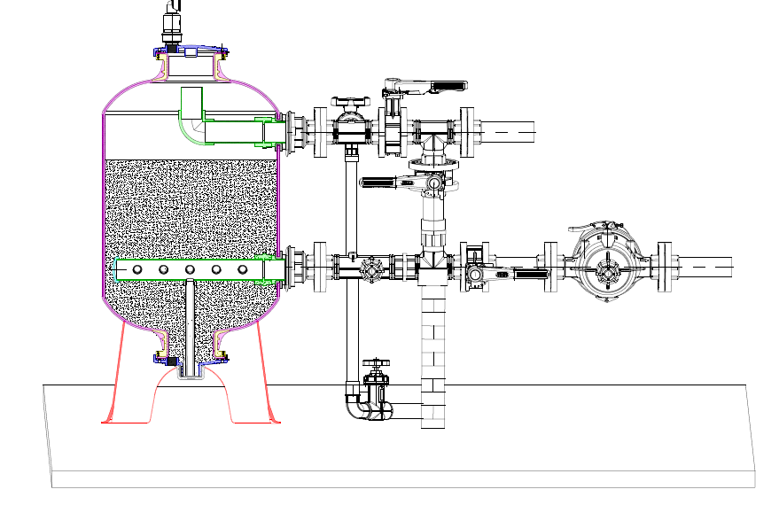
OPERATION
C
A
Fig 3
D
B
E
Open Valve B
Open valve A
Close Valve C
Close Valve D.
2. Now filter is in operation mode.

Slide 11
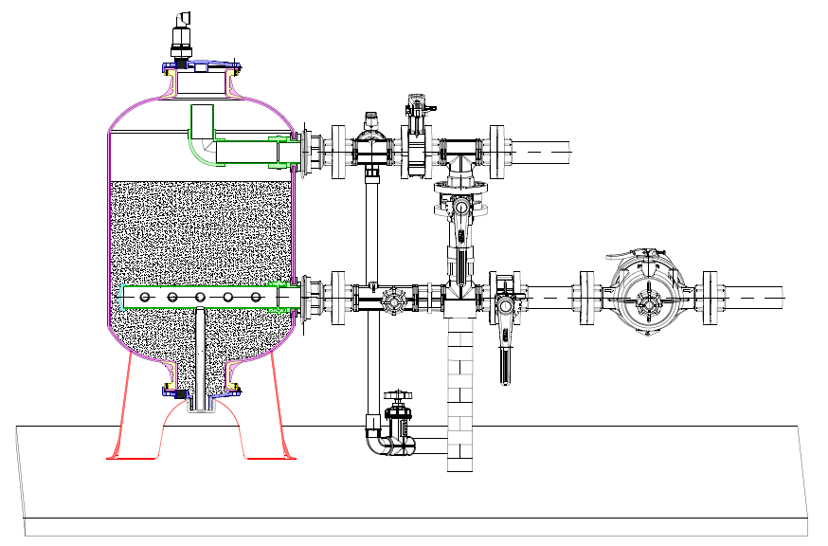
BACK WASHING
A
Fig 4
C
D
B
E
It is highly recommended to do back washing every 3 hours for 90 seconds to properly clean media filter.
Open flush valve C.
Close Outlet valve B.
Open Back wash valve D.
Close Inlet valve A.
It is recommended to maintain backflush flow as given in table 1 at 1.5 kg/cm2 pressure while backwashing the filter to get best results of backwashing .

Slide 12
MAINTANANCE & TROUBLE SHOOTING

Slide 13
SAFETY INSTRUCTIONS
Please read the safety instructions carefully before handling any part of the system.
Maximum working pressure of the filter is 4 kg/cm². before operation make sure that inlet pressure should not be higher than this.
Ensure Inlet Valve A & outlet valve B are open before start of the system.
Do not perform any maintenance or try to open filter parts when filter is in operation. Release filter pressure before doing any maintenance.
Do not apply excessive force or pressure on the filter and backwash assembly.
Always use proper tooling and wrenches for maintenance of the filter
Always use recommended spare parts while replacing them during maintenance.
Do not lift filter assembly buy holding the tank from inlet /Outlet of the filter.
Do not overtight nuts bolts.
Use Teflon tape where ever it is necessary to avoid leakage from threaded joints.
.

Slide 14
TROUBLE SHOOTING GUIDE
SYMPTOMS | PROBABLE CAUSES | SOLUTIONS
Poor filtration | Insufficient / Improper back flushing | Do proper back flushing as given in Back flushing column
 | Insufficient Sand bed height
 |  | Add more media to the recommended level
 | Wrong media selection | Use correct media
 | High pressure differential forcing contaminates through the filter | Do proper back flushing as given in Back flushing column
Poor filtration with the cone formation at in the center of sand bed. | Too High inlet flow rate | Add more tanks to reduce flow per tank
 | Air present in tank causing bed disruption. | Install correct Air vent
Increased frequency of back wash | Change in quality of water source | Check source water. More filters required
 | Insufficient Backwash flow rate | Set proper backwash flow rate as given in Table-1
Constant high pr differential | Filters gets clogged | Scrape top layer from sand , flush tank until gets cleaned. Refill sand to the level.
 | High filter flow | Adjust the inlet flow of water.
 |  | Do proper back flushing as given in table 1
 | Insufficient frequency of back washing
Media going to down stream ( In System) | Mushrooms/flute damaged | Replace the damaged mushroom/flutes
 | Wrong media Used | Exchange correct media

